Slide 1


Factor Analysis
Twinkle Patel
Dataset: Lifestyle and Wellbeing

Slide 2
Variables Used in Factor Analysis
HOW MANY FRUITS OR VEGETABLES DO YOU EAT EVERYDAY?*
HOW MUCH STRESS DO YOU TYPICALLY EXPERIENCE EVERYDAY?*
HOW MANY NEW PLACES DO YOU VISIT?
HOW MANY PEOPLE ARE VERY CLOSE TO YOU?*
HOW MANY PEOPLE DO YOU HELP ACHIEVE A BETTER LIFE?*
WITH HOW MANY PEOPLE DO YOU INTERACT WITH DURING A TYPICAL DAY?*
HOW MANY REMARKABLE ACHIEVEMENTS ARE YOU PROUD OF?*
HOW MANY TIMES DO YOU DONATE YOUR TIME OR MONEY TO GOOD CAUSES?*
WHAT IS YOUR BODY MASS INDEX (BMI) RANGE?*
HOW WELL DO YOU COMPLETE YOUR WEEKLY TO-DO LISTS?*
IN A TYPICAL DAY, HOW MANY HOURS DO YOU EXPERIENCE "FLOW"?*
HOW MANY STEPS (IN THOUSANDS) DO YOU TYPICALLY WALK EVERYDAY?*
FOR HOW MANY YEARS AHEAD IS YOUR LIFE VISION VERY CLEAR FOR?*
ABOUT HOW LONG DO YOU TYPICALLY SLEEP?
HOW MANY DAYS OF VACATION DO YOU TYPICALLY LOSE EVERY YEAR ?
HOW OFTEN DO YOU SHOUT OR SULK AT SOMEBODY?*
HOW SUFFICIENT IS YOUR INCOME TO COVER BASIC LIFE EXPENSES?*
HOW MANY RECOGNITIONS HAVE YOU RECEIVED IN YOUR LIFE?*
HOW MANY HOURS DO YOU SPEND EVERYDAY DOING WHAT YOU ARE PASSIONATE ABOUT?*
IN A TYPICAL WEEK, HOW MANY TIMES DO YOU HAVE THE OPPORTUNITY TO THINK ABOUT YOURSELF?*

Slide 3
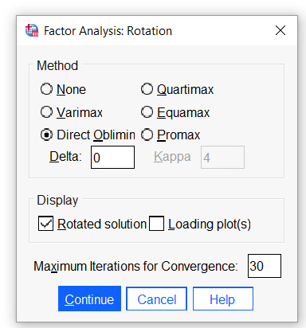
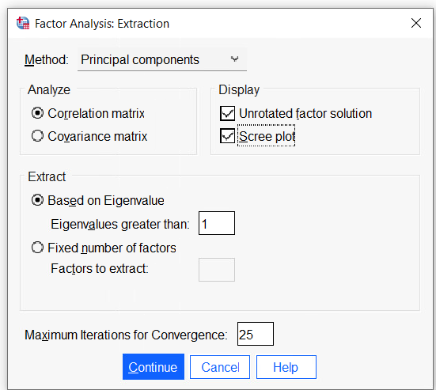
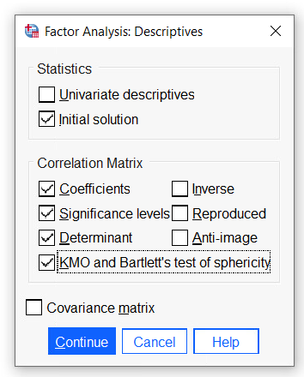
selections
Rotation
Extraction
Descriptives
We will enhance our selection once we know the number of factors determined for further analysis
If the value is >1, then we can say that factor contributes more than 1 single variable.
Oblique Method (Direct Oblimin):
Use when there is a relationship between variables (factors can correlate).
Orthogonal Method (Varimax):
Use when there is no relationship between variables (factors remain independent).

Slide 4
Correlation Matrix
 |  | FRUITS_VEGGIES | DAILY_STRESS | PLACES_VISITED | CORE_CIRCLE | SUPPORTING_OTHERS | SOCIAL_NETWORK | ACHIEVEMENT | DONATION | BMI_RANGE | TODO_COMPLETED | FLOW | DAILY_STEPS | LIVE_VISION | SLEEP_HOURS | LOST_VACATION | DAILY_SHOUTING | SUFFICIENT_INCOME | PERSONAL_AWARDS | TIME_FOR_PASSION | WEEKLY_MEDITATION
 | FRUITS_VEGGIES | 1.000 | -0.078 | 0.227 | 0.085 | 0.204 | 0.024 | 0.138 | 0.227 | -0.043 | 0.177 | 0.082 | 0.169 | 0.132 | 0.155 | -0.100 | -0.112 | 0.178 | 0.156 | 0.067 | 0.251
 | DAILY_STRESS | -0.078 | 1.000 | -0.129 | -0.166 | 0.036 | 0.046 | -0.051 | -0.005 | 0.079 | -0.260 | -0.066 | -0.160 | -0.078 | -0.117 | 0.224 | 0.201 | -0.187 | -0.109 | -0.110 | -0.294
 | PLACES_VISITED | 0.227 | -0.129 | 1.000 | 0.195 | 0.195 | 0.049 | 0.258 | 0.118 | -0.125 | 0.241 | 0.060 | 0.102 | 0.141 | 0.130 | -0.218 | -0.152 | 0.056 | 0.277 | 0.162 | 0.198
 | CORE_CIRCLE | 0.085 | -0.166 | 0.195 | 1.000 | 0.371 | 0.303 | 0.227 | 0.232 | -0.049 | 0.211 | 0.253 | 0.141 | 0.206 | 0.004 | -0.147 | -0.083 | 0.107 | 0.205 | 0.271 | 0.064
 | SUPPORTING_OTHERS | 0.204 | 0.036 | 0.195 | 0.371 | 1.000 | 0.332 | 0.347 | 0.326 | 0.063 | 0.216 | 0.306 | 0.094 | 0.206 | 0.017 | -0.074 | -0.048 | 0.093 | 0.307 | 0.274 | 0.132
 | SOCIAL_NETWORK | 0.024 | 0.046 | 0.049 | 0.303 | 0.332 | 1.000 | 0.187 | 0.094 | 0.017 | 0.112 | 0.230 | 0.128 | 0.118 | 0.009 | 0.171 | -0.029 | -0.011 | 0.160 | 0.198 | -0.068
 | ACHIEVEMENT | 0.138 | -0.051 | 0.258 | 0.227 | 0.347 | 0.187 | 1.000 | 0.166 | 0.005 | 0.291 | 0.287 | 0.143 | 0.292 | 0.047 | -0.038 | 0.006 | 0.095 | 0.426 | 0.212 | 0.139
 | DONATION | 0.227 | -0.005 | 0.118 | 0.232 | 0.326 | 0.094 | 0.166 | 1.000 | 0.146 | 0.179 | 0.143 | 0.088 | 0.199 | -0.055 | -0.040 | -0.108 | 0.171 | 0.291 | 0.086 | 0.104
 | BMI_RANGE | -0.043 | 0.079 | -0.125 | -0.049 | 0.063 | 0.017 | 0.005 | 0.146 | 1.000 | -0.083 | 0.082 | -0.118 | 0.087 | -0.167 | -0.028 | 0.070 | 0.036 | 0.040 | -0.012 | -0.069
 | TODO_COMPLETED | 0.177 | -0.260 | 0.241 | 0.211 | 0.216 | 0.112 | 0.291 | 0.179 | -0.083 | 1.000 | 0.267 | 0.181 | 0.215 | 0.141 | -0.105 | -0.254 | 0.175 | 0.232 | 0.242 | 0.170
 | FLOW | 0.082 | -0.066 | 0.060 | 0.253 | 0.306 | 0.230 | 0.287 | 0.143 | 0.082 | 0.267 | 1.000 | 0.117 | 0.312 | -0.005 | -0.011 | -0.050 | 0.078 | 0.216 | 0.467 | 0.076
 | DAILY_STEPS | 0.169 | -0.160 | 0.102 | 0.141 | 0.094 | 0.128 | 0.143 | 0.088 | -0.118 | 0.181 | 0.117 | 1.000 | 0.101 | -0.043 | -0.109 | -0.044 | 0.156 | 0.119 | 0.128 | 0.079
 | LIVE_VISION | 0.132 | -0.078 | 0.141 | 0.206 | 0.206 | 0.118 | 0.292 | 0.199 | 0.087 | 0.215 | 0.312 | 0.101 | 1.000 | 0.005 | 0.006 | -0.018 | 0.040 | 0.177 | 0.337 | 0.101
 | SLEEP_HOURS | 0.155 | -0.117 | 0.130 | 0.004 | 0.017 | 0.009 | 0.047 | -0.055 | -0.167 | 0.141 | -0.005 | -0.043 | 0.005 | 1.000 | -0.075 | -0.111 | -0.031 | -0.069 | 0.032 | 0.131
 | LOST_VACATION | -0.100 | 0.224 | -0.218 | -0.147 | -0.074 | 0.171 | -0.038 | -0.040 | -0.028 | -0.105 | -0.011 | -0.109 | 0.006 | -0.075 | 1.000 | 0.106 | -0.100 | -0.123 | -0.032 | -0.179
 | DAILY_SHOUTING | -0.112 | 0.201 | -0.152 | -0.083 | -0.048 | -0.029 | 0.006 | -0.108 | 0.070 | -0.254 | -0.050 | -0.044 | -0.018 | -0.111 | 0.106 | 1.000 | -0.050 | 0.006 | -0.111 | -0.113
 | SUFFICIENT_INCOME | 0.178 | -0.187 | 0.056 | 0.107 | 0.093 | -0.011 | 0.095 | 0.171 | 0.036 | 0.175 | 0.078 | 0.156 | 0.040 | -0.031 | -0.100 | -0.050 | 1.000 | 0.154 | 0.015 | 0.170
 | PERSONAL_AWARDS | 0.156 | -0.109 | 0.277 | 0.205 | 0.307 | 0.160 | 0.426 | 0.291 | 0.040 | 0.232 | 0.216 | 0.119 | 0.177 | -0.069 | -0.123 | 0.006 | 0.154 | 1.000 | 0.223 | 0.221
 | TIME_FOR_PASSION | 0.067 | -0.110 | 0.162 | 0.271 | 0.274 | 0.198 | 0.212 | 0.086 | -0.012 | 0.242 | 0.467 | 0.128 | 0.337 | 0.032 | -0.032 | -0.111 | 0.015 | 0.223 | 1.000 | 0.139
 | WEEKLY_MEDITATION | 0.251 | -0.294 | 0.198 | 0.064 | 0.132 | -0.068 | 0.139 | 0.104 | -0.069 | 0.170 | 0.076 | 0.079 | 0.101 | 0.131 | -0.179 | -0.113 | 0.170 | 0.221 | 0.139 | 1.000
Principal Diagonal
Examine Relationship between variables
Correlation goes from 0, +1, -1
0.8 and high value, meaning the problem of multicollinearity
Any +1-value other than the principal diagonal called Singularity
Need to delete

Slide 5
Correlation Significant value Matrix
 |  | FRUITS_VEGGIES | DAILY_ STRESS | PLACES_ VISITED | CORE_ CIRCLE | SUPPORTING_OTHERS | SOCIAL_NETWORK | ACHIEVEMENT | DONATION | BMI_RANGE | TODO_COMPLETED | FLOW | DAILY_STEPS | LIVE_VISION | SLEEP_HOURS | LOST_VACATION | DAILY_SHOUTING | SUFFICIENT_INCOME | PERSONAL_AWARDS | TIME_FOR_PASSION | WEEKLY_MEDITATION
 | FRUITS_VEGGIES |  | 0.041 | 0.000 | 0.029 | 0.000 | 0.295 | 0.001 | 0.000 | 0.169 | 0.000 | 0.034 | 0.000 | 0.002 | 0.000 | 0.013 | 0.006 | 0.000 | 0.000 | 0.066 | 0.000
 | DAILY_STRESS | 0.041 |  | 0.002 | 0.000 | 0.210 | 0.152 | 0.127 | 0.452 | 0.040 | 0.000 | 0.069 | 0.000 | 0.040 | 0.004 | 0.000 | 0.000 | 0.000 | 0.008 | 0.007 | 0.000
 | PLACES_VISITED | 0.000 | 0.002 |  | 0.000 | 0.000 | 0.138 | 0.000 | 0.004 | 0.003 | 0.000 | 0.089 | 0.011 | 0.001 | 0.002 | 0.000 | 0.000 | 0.107 | 0.000 | 0.000 | 0.000
 | CORE_CIRCLE | 0.029 | 0.000 | 0.000 |  | 0.000 | 0.000 | 0.000 | 0.000 | 0.136 | 0.000 | 0.000 | 0.001 | 0.000 | 0.464 | 0.001 | 0.032 | 0.008 | 0.000 | 0.000 | 0.077
 | SUPPORTING_OTHERS | 0.000 | 0.210 | 0.000 | 0.000 |  | 0.000 | 0.000 | 0.000 | 0.079 | 0.000 | 0.000 | 0.018 | 0.000 | 0.356 | 0.048 | 0.141 | 0.019 | 0.000 | 0.000 | 0.001
 | SOCIAL_NETWORK | 0.295 | 0.152 | 0.138 | 0.000 | 0.000 |  | 0.000 | 0.017 | 0.355 | 0.006 | 0.000 | 0.002 | 0.004 | 0.421 | 0.000 | 0.260 | 0.401 | 0.000 | 0.000 | 0.065
 | ACHIEVEMENT | 0.001 | 0.127 | 0.000 | 0.000 | 0.000 | 0.000 |  | 0.000 | 0.452 | 0.000 | 0.000 | 0.001 | 0.000 | 0.147 | 0.196 | 0.442 | 0.017 | 0.000 | 0.000 | 0.001
 | DONATION | 0.000 | 0.452 | 0.004 | 0.000 | 0.000 | 0.017 | 0.000 |  | 0.001 | 0.000 | 0.001 | 0.025 | 0.000 | 0.108 | 0.184 | 0.008 | 0.000 | 0.000 | 0.027 | 0.010
 | BMI_RANGE | 0.169 | 0.040 | 0.003 | 0.136 | 0.079 | 0.355 | 0.452 | 0.001 |  | 0.032 | 0.034 | 0.004 | 0.027 | 0.000 | 0.269 | 0.059 | 0.209 | 0.189 | 0.394 | 0.063
 | TODO_COMPLETED | 0.000 | 0.000 | 0.000 | 0.000 | 0.000 | 0.006 | 0.000 | 0.000 | 0.032 |  | 0.000 | 0.000 | 0.000 | 0.001 | 0.010 | 0.000 | 0.000 | 0.000 | 0.000 | 0.000
 | FLOW | 0.034 | 0.069 | 0.089 | 0.000 | 0.000 | 0.000 | 0.000 | 0.001 | 0.034 | 0.000 |  | 0.005 | 0.000 | 0.454 | 0.402 | 0.131 | 0.040 | 0.000 | 0.000 | 0.044
 | DAILY_STEPS | 0.000 | 0.000 | 0.011 | 0.001 | 0.018 | 0.002 | 0.001 | 0.025 | 0.004 | 0.000 | 0.005 |  | 0.012 | 0.168 | 0.007 | 0.162 | 0.000 | 0.004 | 0.002 | 0.038
 | LIVE_VISION | 0.002 | 0.040 | 0.001 | 0.000 | 0.000 | 0.004 | 0.000 | 0.000 | 0.027 | 0.000 | 0.000 | 0.012 |  | 0.452 | 0.444 | 0.342 | 0.189 | 0.000 | 0.000 | 0.012
 | SLEEP_HOURS | 0.000 | 0.004 | 0.002 | 0.464 | 0.356 | 0.421 | 0.147 | 0.108 | 0.000 | 0.001 | 0.454 | 0.168 | 0.452 |  | 0.046 | 0.006 | 0.244 | 0.062 | 0.239 | 0.002
 | LOST_VACATION | 0.013 | 0.000 | 0.000 | 0.001 | 0.048 | 0.000 | 0.196 | 0.184 | 0.269 | 0.010 | 0.402 | 0.007 | 0.444 | 0.046 |  | 0.009 | 0.012 | 0.003 | 0.238 | 0.000
 | DAILY_SHOUTING | 0.006 | 0.000 | 0.000 | 0.032 | 0.141 | 0.260 | 0.442 | 0.008 | 0.059 | 0.000 | 0.131 | 0.162 | 0.342 | 0.006 | 0.009 |  | 0.131 | 0.451 | 0.007 | 0.006
 | SUFFICIENT_INCOME | 0.000 | 0.000 | 0.107 | 0.008 | 0.019 | 0.401 | 0.017 | 0.000 | 0.209 | 0.000 | 0.040 | 0.000 | 0.189 | 0.244 | 0.012 | 0.131 |  | 0.000 | 0.371 | 0.000
 | PERSONAL_AWARDS | 0.000 | 0.008 | 0.000 | 0.000 | 0.000 | 0.000 | 0.000 | 0.000 | 0.189 | 0.000 | 0.000 | 0.004 | 0.000 | 0.062 | 0.003 | 0.451 | 0.000 |  | 0.000 | 0.000
 | TIME_FOR_PASSION | 0.066 | 0.007 | 0.000 | 0.000 | 0.000 | 0.000 | 0.000 | 0.027 | 0.394 | 0.000 | 0.000 | 0.002 | 0.000 | 0.239 | 0.238 | 0.007 | 0.371 | 0.000 |  | 0.001
 | WEEKLY_MEDITATION | 0.000 | 0.000 | 0.000 | 0.077 | 0.001 | 0.065 | 0.001 | 0.010 | 0.063 | 0.000 | 0.044 | 0.038 | 0.012 | 0.002 | 0.000 | 0.006 | 0.000 | 0.000 | 0.001
Determinant = .044
* This value should be greater than .0001
* .044 is okay, indicating some level of relationship between variables.

Slide 6
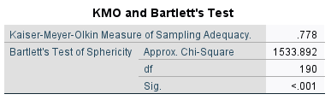
KMO and Bartlett's Test
The KMO test evaluates whether we have a sufficient sample size for our data.
We are looking for 0.5 or higher. A higher KMO value indicates that the sample is adequate for factor analysis, helping ensure reliable and valid results.
Test of Sphericity shows the signification; the value should be less than or equal to 0.05

Slide 7
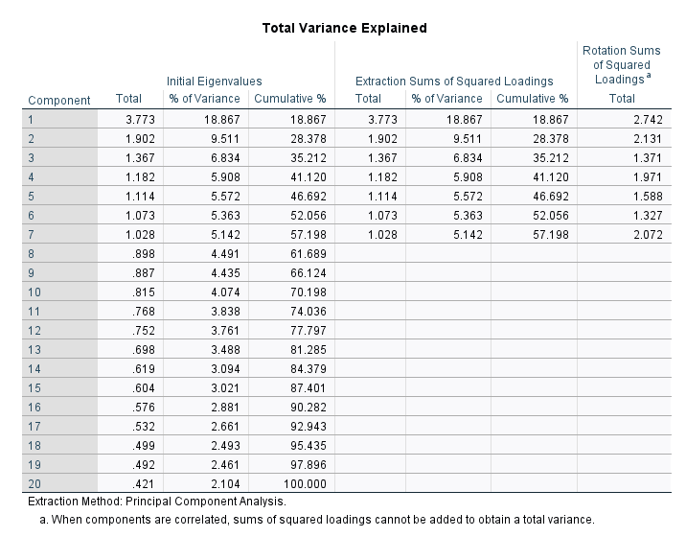
Total Variance Explained
This table explains eigenvalues, eigenvalues of 1 or more, meaning the factor contributes more than just a single variable.
An eigenvalue below 1 indicates that the factor explains less variance than a single observed variable, suggesting it is not significant enough to retain in the analysis.
cumulative variance of 57% indicates that the extracted factors explain over half of the total variability in the dataset

Slide 8
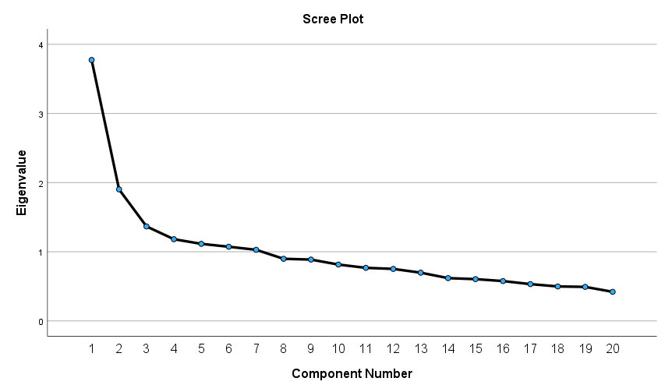
Scree Plot
Scree Plot is a valuable tool in factor analysis, providing a clear visual
This means that the factors before this point explain a lot of variance in the data,
while those after the 7th factor contribute much less.

Slide 9
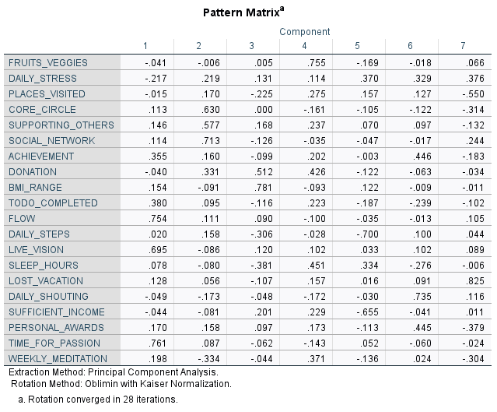
Pattern Matrix
The Pattern Matrix displays the factor loadings, which represent how much each variable correlates with each factor.
High loadings indicate a strong relationship, while low loadings suggest a weak relationship.
Also to see how variables load onto different factors

Slide 10
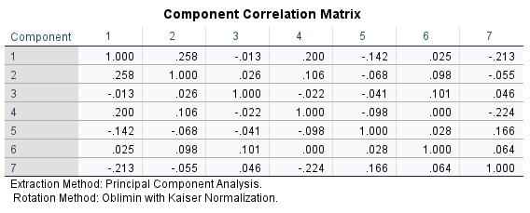
Component Correlation Matrix
We are looking for factor loadings higher than 0.32.
Since We do not have any value above 0.32, we should consider using the Varimax rotation method to enhance the clarity and improve the factor loadings."

Slide 11
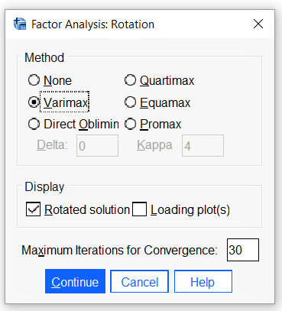
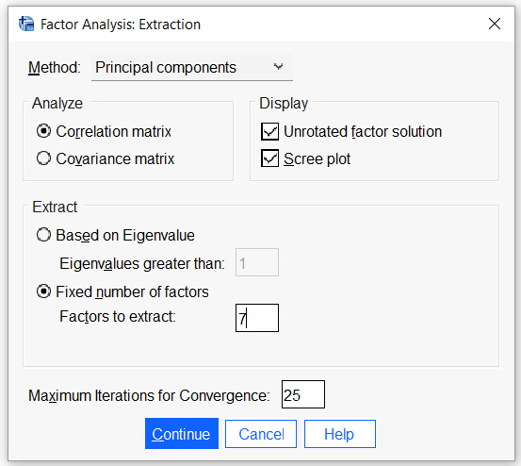
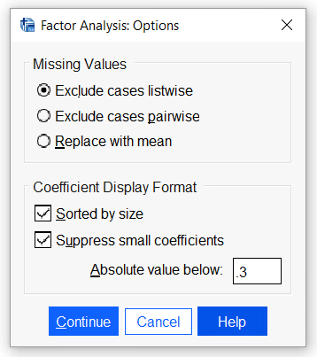
Changing Method and Options
Sorting by Size helps you quickly identify which variables have the strongest relationships with each factor.
Loadings of 0.3 or higher indicate meaningful, moderate relationships between variables and factors, enhancing the clarity of the analysis.
I have changed the rotation method to Varimax to improve the factor loadings and achieve clearer results in the analysis.
Also fixed the number of factors, since we know how many factors we will use in the further analysis

Slide 12
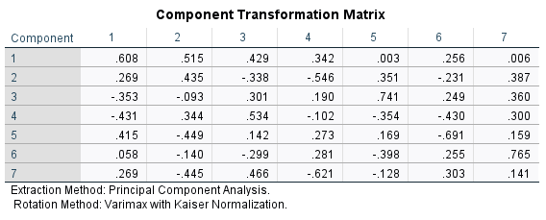
Component Transformation Matrix
Improvement: Highlighting that the Varimax rotation has led to better clarity and the identification of significant values is important.
We are now able to identify values greater than 0.32, which highlights the meaningful relationships within the data

Slide 13
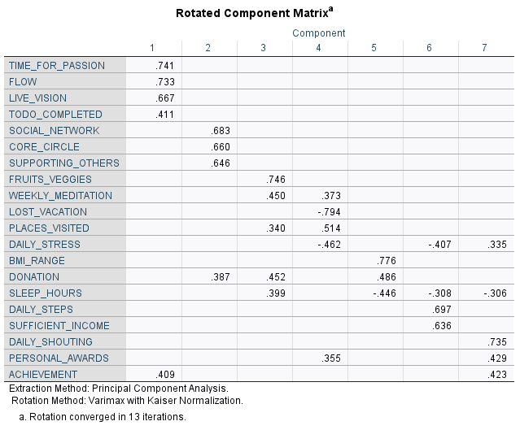
Rotated Component Matrix
This highlights the strong relationships between the variables across the identified factors
For example, TIME_FOR_PASSION (0.741) and FLOW (0.733) have strong loadings on Component 1, indicating that these variables are highly associated with this factor
Meaningful Factor Labels
Component 1: Personal Fulfillment
Component 2: Social Connections
Component 3: Health and Wellness
Component 4: Stress and Time Management
Component 5: Physical Health
Component 6: Lifestyle Activities
Component 7: Achievement and Recognition

Slide 14
Conclusions
Learned:
We have learned the key patterns that simplify the complex relationships in the data.
Gained by this process:
We have gained a clearer understanding of the main factors influencing Wellbeing and lifestyle.
How did the manager identify Factors?
The newly identified factors can be used to make more targeted decisions and improvements.

Slide 15


